Slide 1



Embedded sensors
Pausing print tutorial
2017-1-DE03-KA201-035615

Slide 2
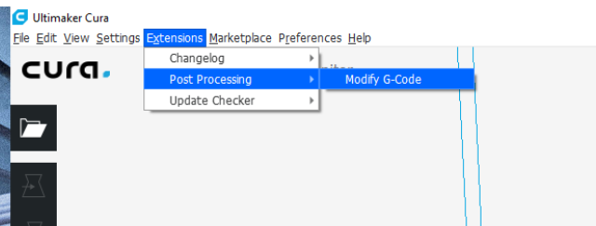
Pausing print: Cura
In Cura open the "post processing" and select "modify G-Code" menu in "Extensions"
2017-1-DE03-KA201-035615

Slide 3
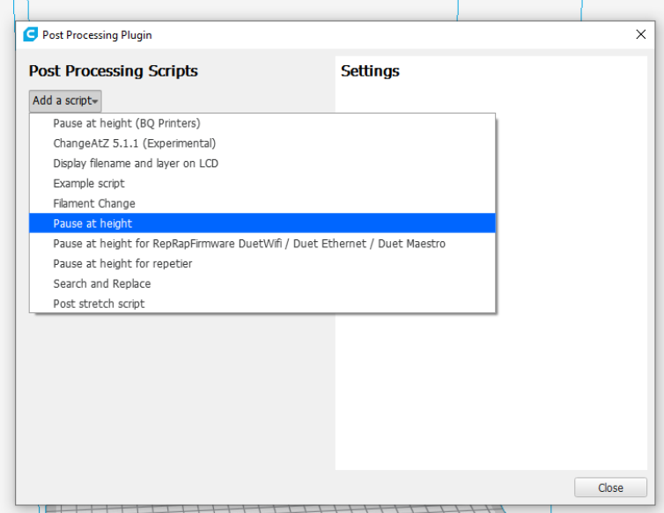
Pausing print: Cura
In this menu select "Pause at height" from the "Add a script" menu.
2017-1-DE03-KA201-035615

Slide 4
Pausing print: Cura
In this menu select "Pause at height" from the "Add a script" menu.
2017-1-DE03-KA201-035615

Slide 5
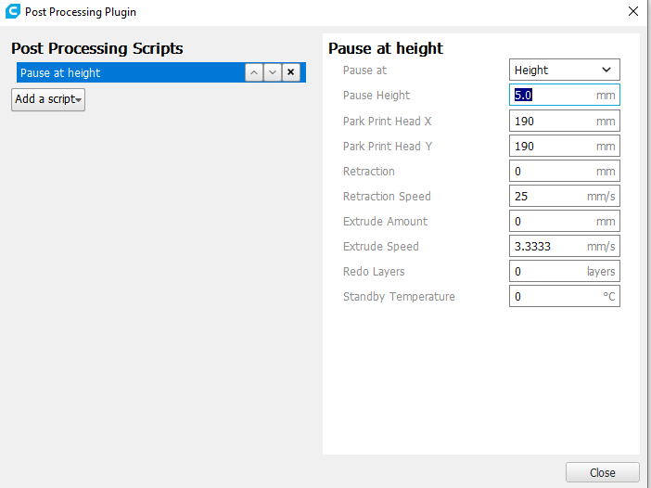
Pausing print: Cura
Now insert your pause, at the correct height. Refer to your CAD software for the correct meassurements
2017-1-DE03-KA201-035615

Slide 6
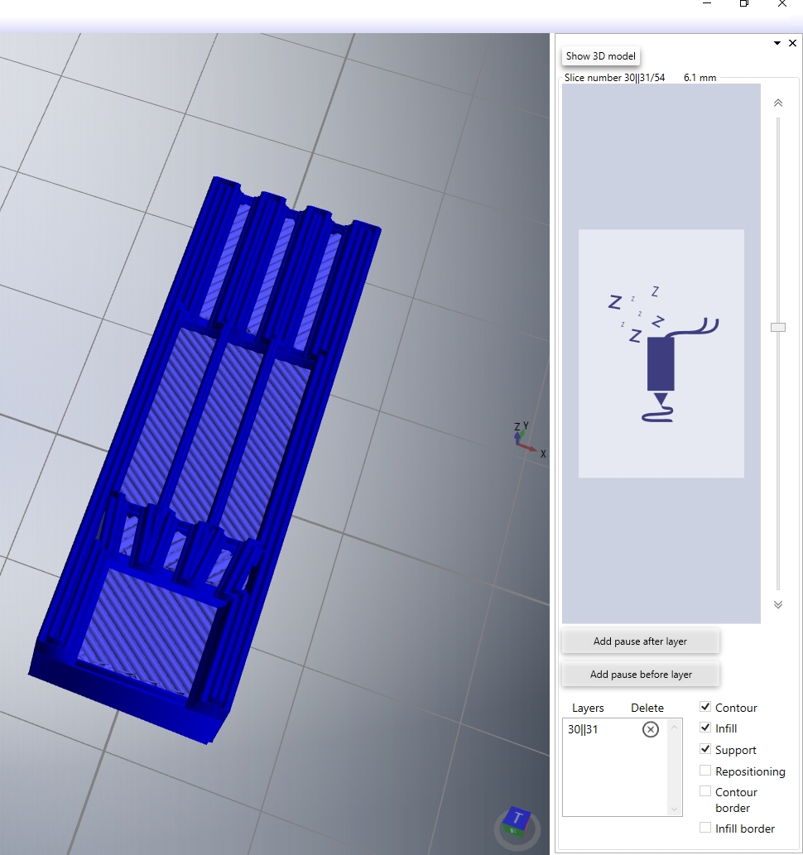
Pausing print: REALvision
Navigate to the layer you want, and ad a pause either before or after a layer, using the buttons
2017-1-DE03-KA201-035615

