Slide 1



Embedded sensors
Warm up excercise
2017-1-DE03-KA201-035615

Slide 2
Agenda:
Divide class into two groups A and B
Have parallel activities for the groups
Make pairs with students from each previous group
Work on embedded sensor in pairs
 | Group A | Group B
Pair 1 | Student 1 | Student 2
Pair 2 | Student 3 | Student 4
Pair 3 | Student 5 | Student 6
Pair 4 | Student 7 | Student 8
Pair 5 | Student 9 | Student 10
2017-1-DE03-KA201-035615

Slide 3
Parallel activities.
Group A
15 mins: Lecture on sensors
2 hours: Build a simple circuit
Group B
15 mins: Making a puzzle
2 hours: Designing and printing puzzle pieces.
2017-1-DE03-KA201-035615

Slide 4

Group A: What is a sensor?
Cues:
Does a human have sensors? Which?
Is there an electronic equivalent to the 5 basic human sensors?
2017-1-DE03-KA201-035615

Slide 5
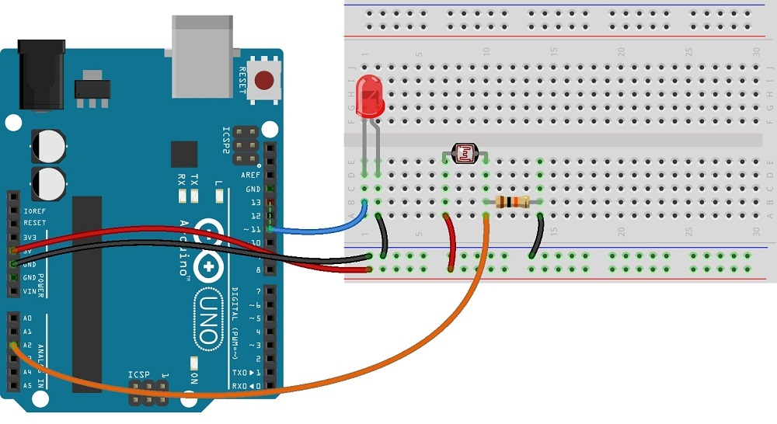
Group A: Let there be light!
A photocell can measure light
Exercise: Make a small circuit that will turn on a light, when the room goes dark.
2017-1-DE03-KA201-035615

Slide 6

Group B: A puzzling fit
Divide into 4 groups.
Each group will design a puzzle piece as shown to the right:
The pieces must fit together
2017-1-DE03-KA201-035615

Slide 7
Group B: A puzzling fit
Make a 2D drawing on paper, with measurements
Design the pieces, and 3D print them.
See if they fit together.
2017-1-DE03-KA201-035615

Slide 8
Group B:Question time!
Did the 1st version of the puzzle pieces fit together?
What problems did you face with fitting?
What 3 recommendation would you give to someone about to perform the same task?
2017-1-DE03-KA201-035615

Slide 9
Whole class:
Divide into pairs to work together on the new task.
Explain to each other, what you did in the previous task.
2017-1-DE03-KA201-035615

