Slide 1



Embedded sensors
2017-1-DE03-KA201-035615

Slide 2
Whole class:
Divide into pairs to work together on the new task.
Explain to each other, what you did in the previous task.
2017-1-DE03-KA201-035615

Slide 3
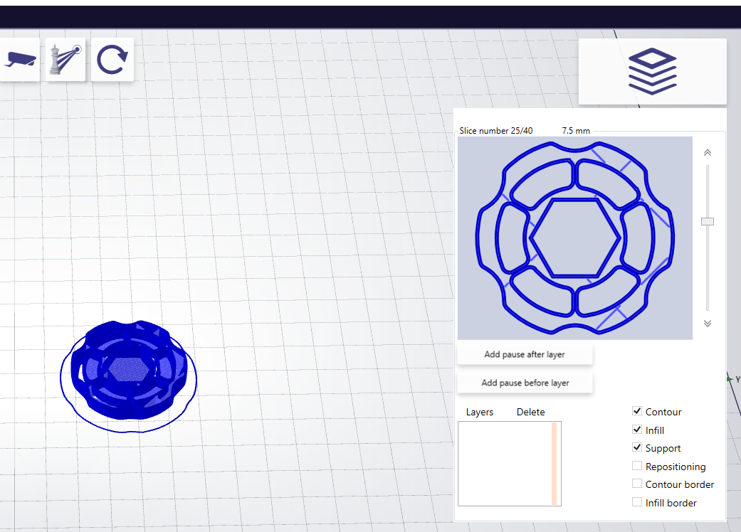
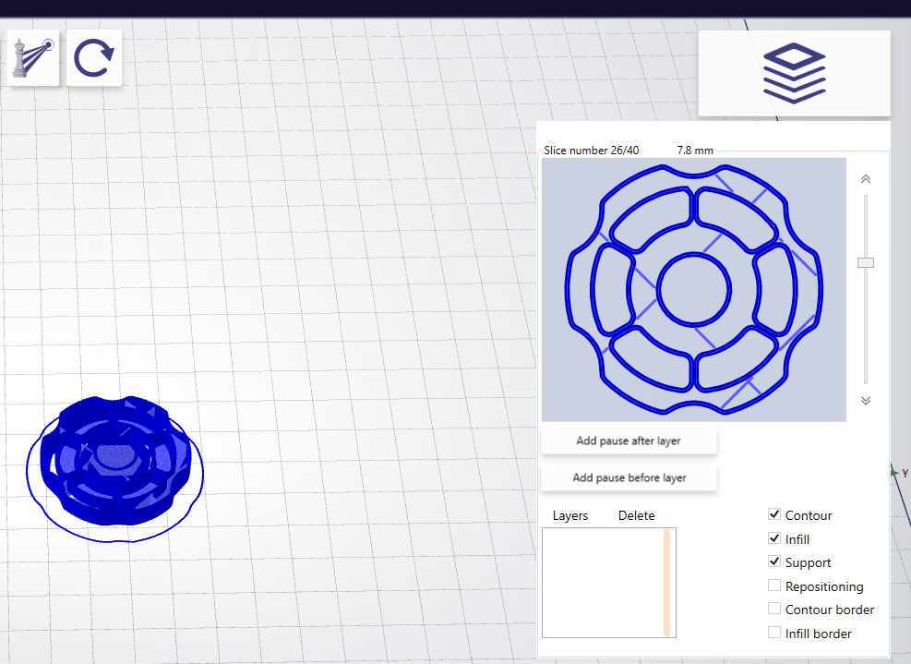
Whole class: Pausing 3D printer
Inserting a pause between these two layers, allows you to insert and object, and print on top of it.
https://reprap.org/forum/read.php?1,301560
2017-1-DE03-KA201-035615

Slide 4
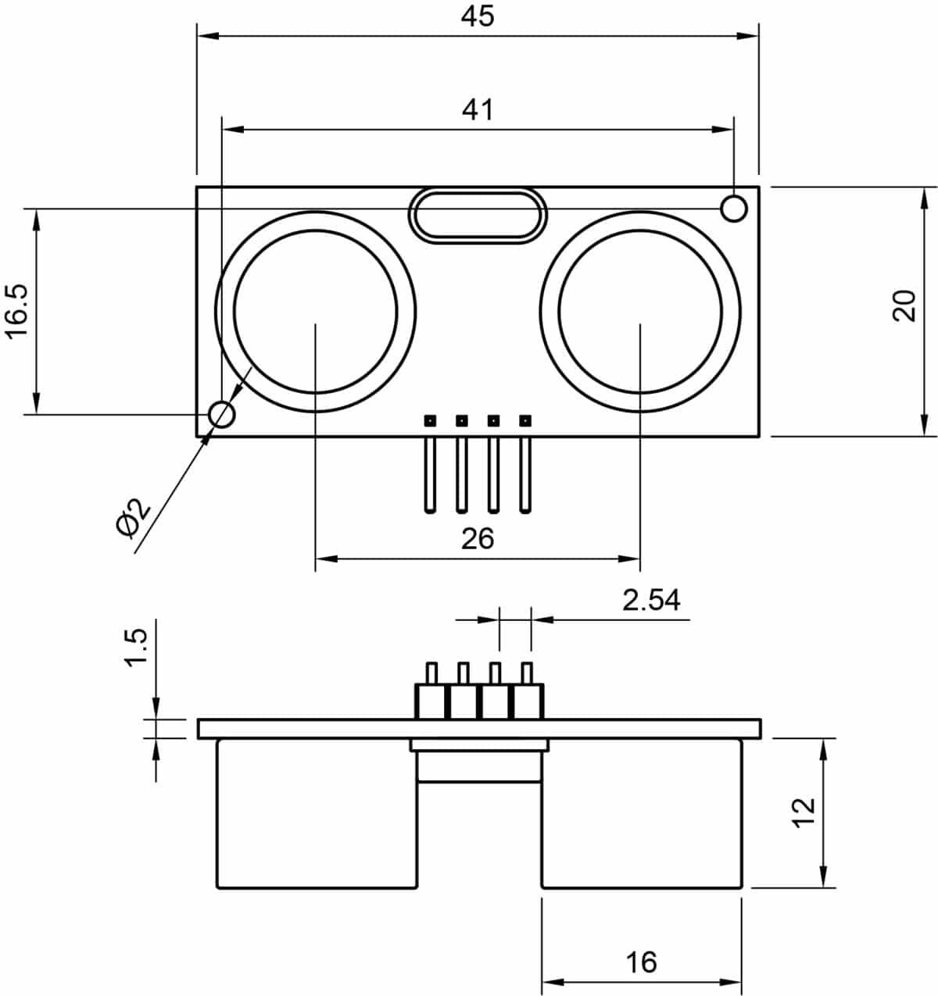
Embedding distance sensor
Find a use for embedding a distance sensor.
  Ex: A radio-controlled race car body with an embedded distance sensor, so that it will not crash into walls.
Use the drawing on the right to create an embedded distance sensor in an object.
Code a solution that can read the input from the sensor
2017-1-DE03-KA201-035615

Slide 5
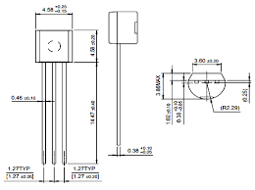
Embedding heat sensor
Find a use for an embedded heat sensor
  Ex: And E-Nable "finger" with a sensor and an LED that lights up, if you touch something too hot.
Use the drawing on the right to create an object with an embedded heat sensor.
Code a solution that can read the input from the sensor
2017-1-DE03-KA201-035615

Slide 6
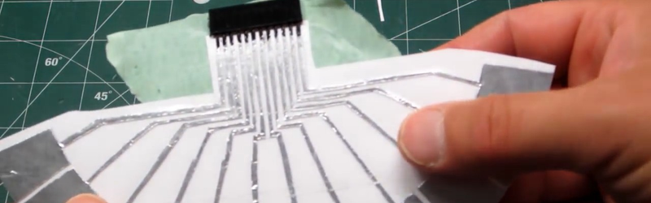
Embedding touch sensor
Find a use for an embedded touch sensor
  Ex: Easy cleanable hand sanitizer dispenser.
Use this video for instruction on how to create a capacitive sensor from tinfoil. How to embed this into a 3D printed object? https://hackaday.com/2015/11/30/conjuring-capacitive-touch-sensors-from-paper-and-aluminum-foil/
Code a solution that can read the input from the sensor
2017-1-DE03-KA201-035615

