Slide 1
Introduction to Parametric Design
Anders Bod Lund – Create it REAL
2017-1-DE03-KA201-035615

Slide 2
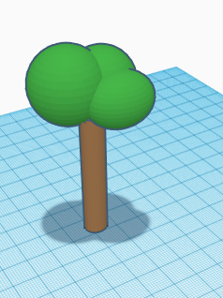
Parametric design - Why?
Go into tinkercad
Draw a tree
Now draw a hundred different trees!
You know how to do step 1 and 2, but what about step 3?
2017-1-DE03-KA201-035615

Slide 3
Coding shapes
Think about how we can represent shapes with math, and therefore also with code
What shapes could you associate the following words with:
Radius
Width
Length
Height
2017-1-DE03-KA201-035615

Slide 4
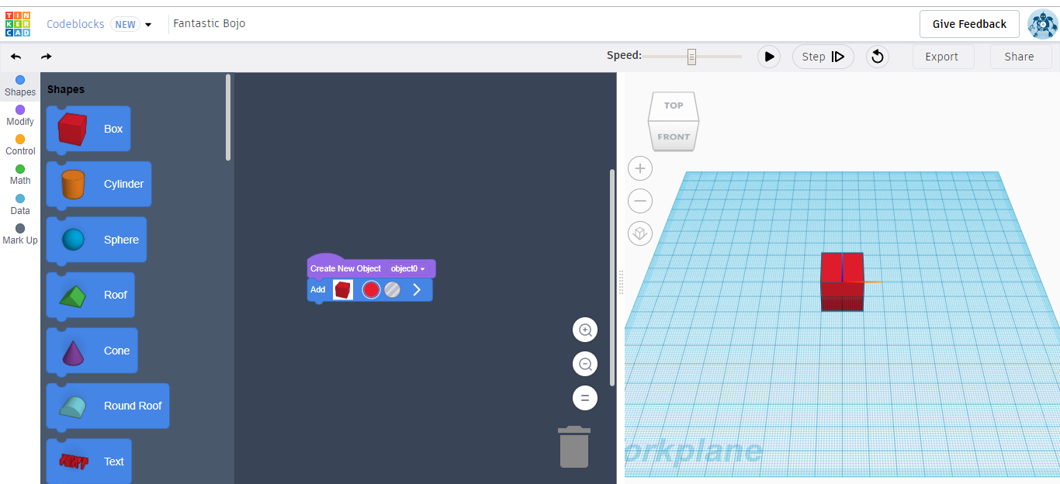
TinkerCAD codeblocks:
1) Drag' n'drop
3) Press the play button to see the resultresult
2) Your programprogramcoour
2017-1-DE03-KA201-035615

Slide 5
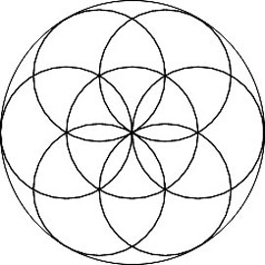
Task One: Create a FlowerFlowerOne:
Make a flat cylinder
Move it along one or more of the axesaxisaxiMove
Repeat!Repeat!Repeat
2017-1-DE03-KA201-035615

Slide 6
TinkerCAD code blocks intro
Watch this video to get familiar with TinkerCAD code blocks: https://www.youtube.com/watch?v=FlsmkPCYIzc
2017-1-DE03-KA201-035615

Slide 7
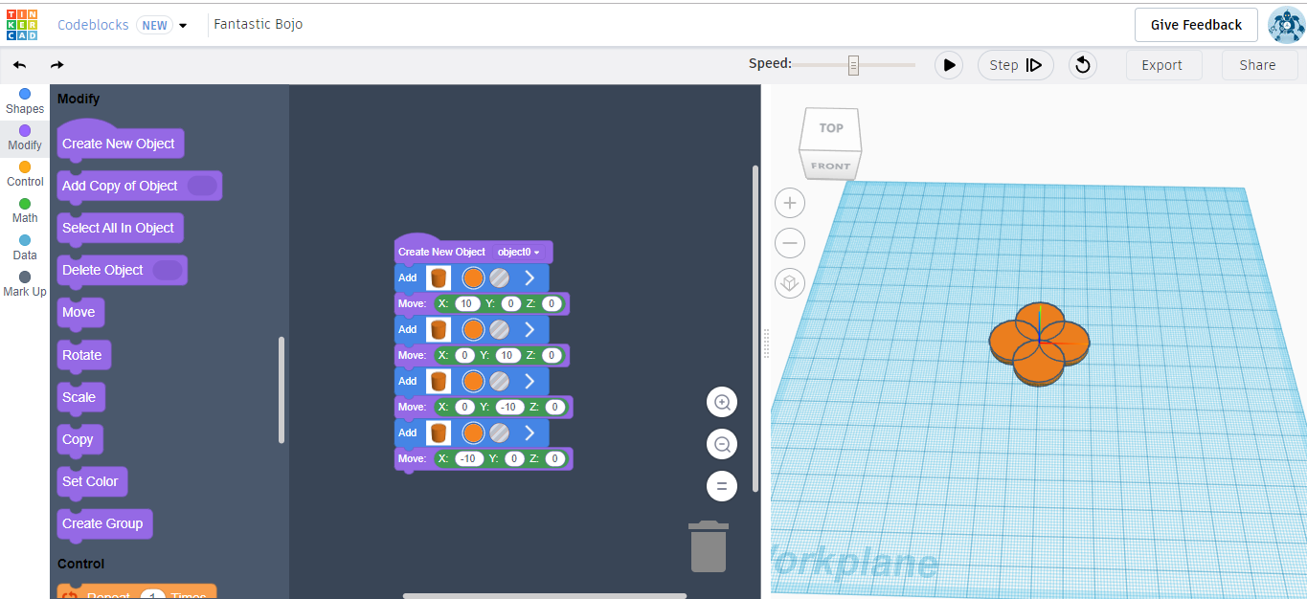
Task One: Create a Flower - Method 1solutsolution
2017-1-DE03-KA201-035615

Slide 8
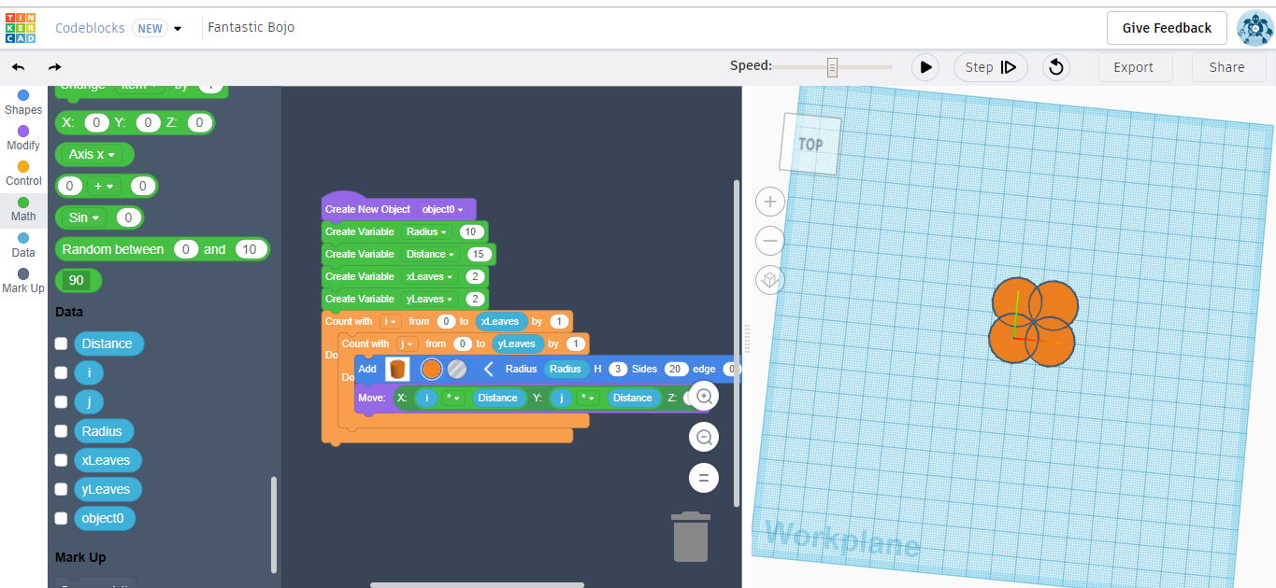
Task One: Create a Flower - Method 2
2017-1-DE03-KA201-035615

Slide 9
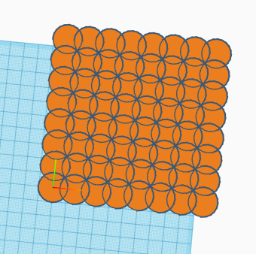
Reflection
What is the difference between the two methods of making a flower?
How can you make the pattern to the right using:
Method 1
Method 2
2017-1-DE03-KA201-035615

Slide 10
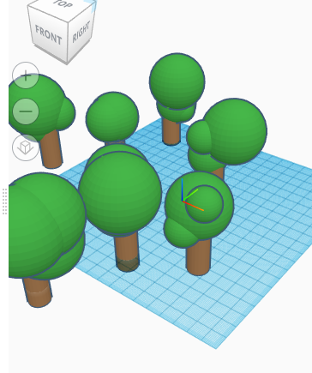
Task 2 - A forest
Make a program that can auto generate a forest.
Make use of the Random number function in order to make each element of the forest different.
2017-1-DE03-KA201-035615

