Slide 1
One Pixel User Interface - communicating information in IoT devices
2017-1-DE03-KA201-035615

Slide 2
Communication with Digital devices.
Screens - Much of the information we get from our devices today comes from scree.
IoT - Due to limitations in power consumption and size it might not be feasible to use screens to convey information.
Therefore, this exercise lets you explore how to create effective communication for IoT devices using only LED's!
Two ways of conveying information using LED's
Colour
Blinking
2017-1-DE03-KA201-035615

Slide 3
Make your own PWM
int ledPin = 6;
void setup() {
pinMode(ledPin, OUTPUT);
}
void loop() {
myBlink( )
}
void myBlink(int onDuration, int offDuration){
digitalWrite(ledPin, HIGH);
delay(onDuration);
digitalWrite(ledPin, LOW);
delay(offDuration);
}
Consider the code on the right, and answer these questions:
What happens if you call myBlink with "1" for both onDuration and offDuration?
What happens if you calle myBlink with onDuration = 2 and offDuration = 1 and vice versa?
Try it out with an Arduino!
2017-1-DE03-KA201-035615

Slide 4
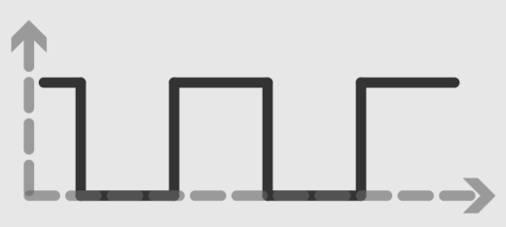
Pulse Width Modulation (PWM)
https://www.arduino.cc/en/Tutorial/PWM
2017-1-DE03-KA201-035615

Slide 5
Research: How to communicate your message
For your IoT device you might need to convey some simple information to your users.
Write down all the states your IoT device can be in and consider how to communicate these states with colored LED's
2017-1-DE03-KA201-035615

Slide 6
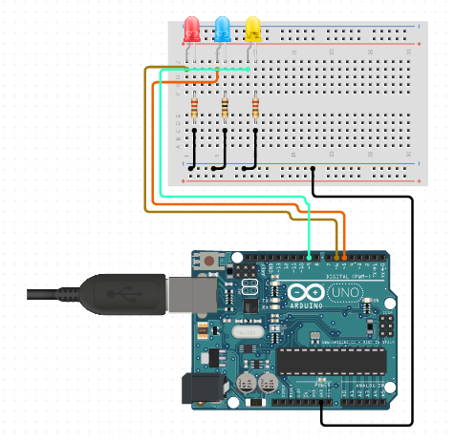
Prototype: Getting ready for test!
Make a prototype using an Arduino (or similar micro controller) and LED's of the chosen colour.
Code a solution that works the way you planned.
Make an incasing for your device so you can easily replace the LED if needed.
2017-1-DE03-KA201-035615

Slide 7
Prototype: Getting ready for test!
Make a prototype using an Arduino (or similar micro controller) and LED's of the chosen colour.
Code a solution that works the way you planned.
Make a test to assess how well the message was communicated, look at this for inspiration: https://usabilityhour.com/start-user-testing/
2017-1-DE03-KA201-035615

Slide 8
Iterate!
What did you learn from your user test?
Use this knowledge to make modifications.
Retest your device to make sure the modifications were effective.
Repeat!
Build
Learn
Meassure
2017-1-DE03-KA201-035615

