Slide 1
Model of a smart home
Authors: Physics Teacher Gabriel State and WeMakers RO team
2017-1-DE03-KA201-035615

Slide 2
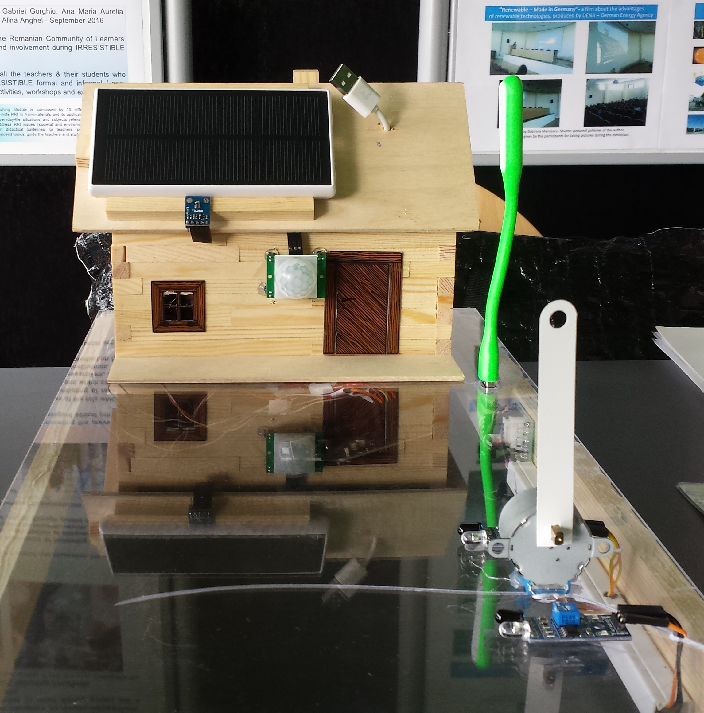
The main functions of the house
Production and storage of the necessary electrical energy in the battery
Monitoring of some operating, ambient parameters and their remote transmission: temperature, humidity, IR, UV and visible radiation intensity, methane gas concentration, instantaneous electrical power, consumed electricity;
Automate processes such as closing / opening of entrance barrier, turning on/off the light that illuminates the yard
2017-1-DE03-KA201-035615

Slide 3
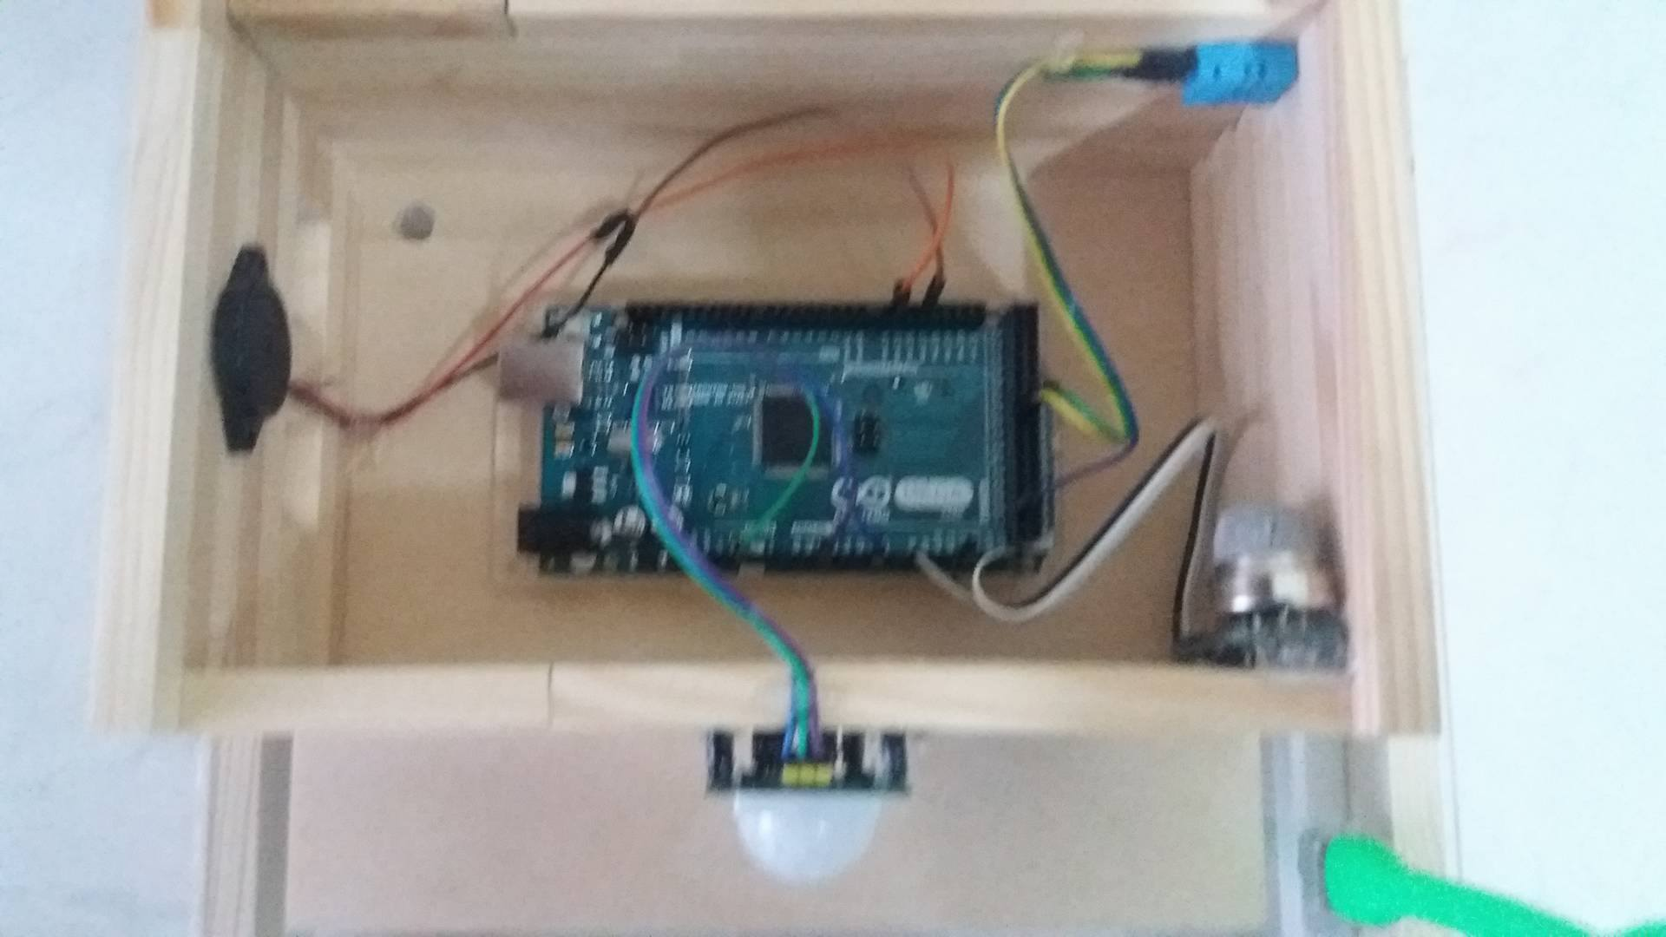
Hardware
Solar battery 5V/2200 mAh
Arduino Mega board
Sensors for: methane gas, radiations, atmospheric measurements (pressure, temperature and humidity), motion detection, proximity sensors
2017-1-DE03-KA201-035615

Slide 4
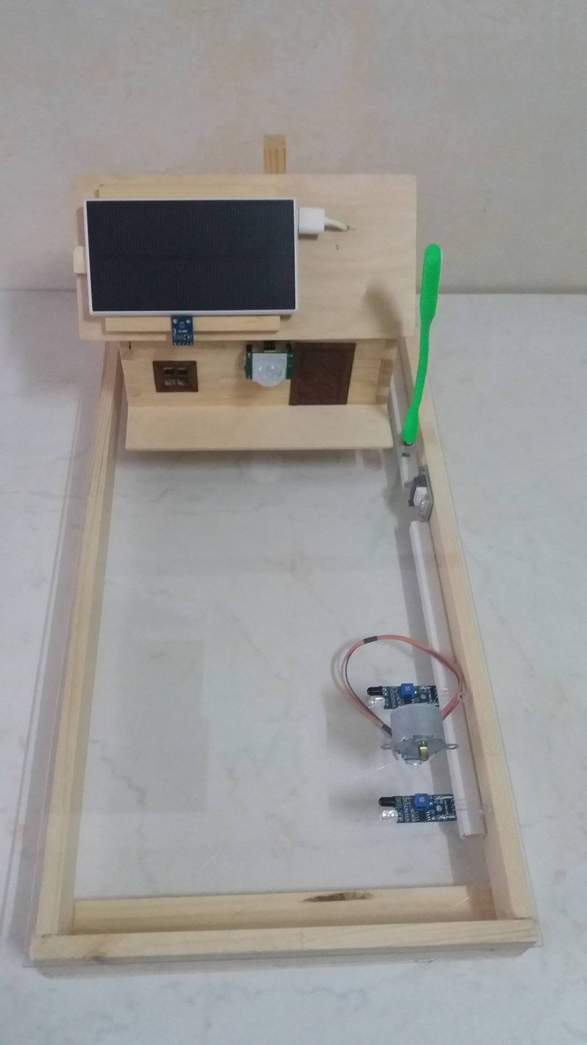
Hardware
Servomotor for entrance barrier;
Bluetooth communication module ;
LED USB lamp for exterior lighting;
Wooden house model kit;
2017-1-DE03-KA201-035615

Slide 5
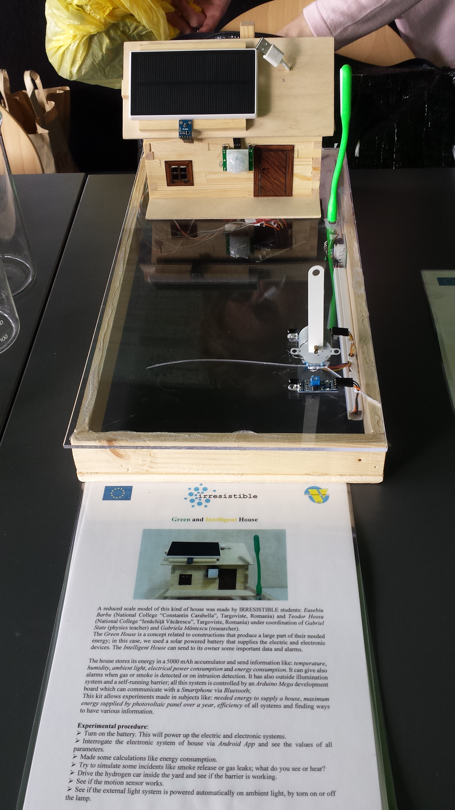
How it works
Solar energy is captured by the photovoltaic panel of the battery and stored or consumed as needed;
The motherboard to which the sensors are connected, monitors their status and makes decisions according to the program: to transmit the atmospheric and electrical values and any alarms.
The barrier is independent of the motherboard but it is powered by the house's electrical system;
The exterior lighting is activated according to the outside lighting level;
2017-1-DE03-KA201-035615

Slide 6
Conclusions
The "Smart House" educational module allows for a detailed study of the radiation and atmospheric parameters in a given area over a year
The realization of this involves the carrying out of several group activities: general design, plant and device design, building blocks, programming and verification of their functionality.
2017-1-DE03-KA201-035615

