Slide 1
Smart house 1
Authors: UVT team in collaboration with Gabriel State, Physics teacher and, Romania
2017-1-DE03-KA201-035615

Slide 2
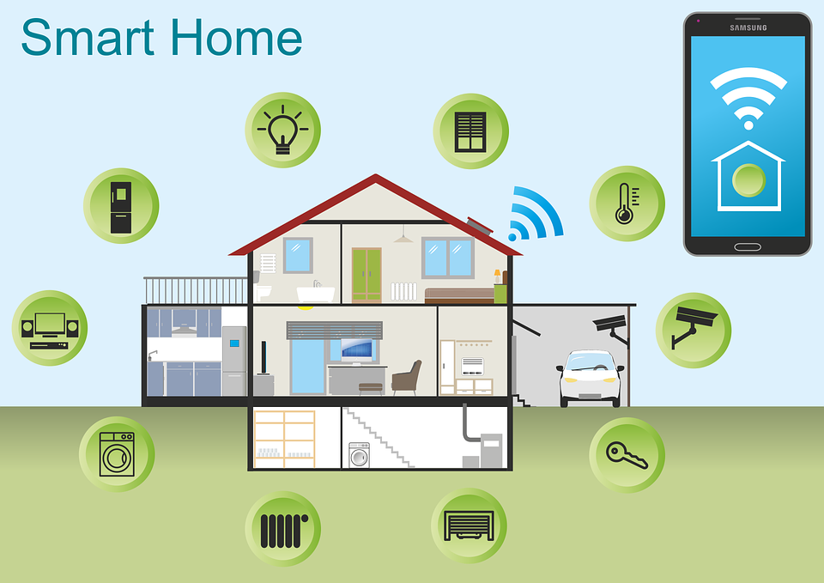
What is a smart house(home)?
a home equipped with lighting, heating, and electronic devices that can be controlled remotely by smartphone or computer.
Image sourse: https://cdn.pixabay.com/photo/2017/01/24/18/02/smart-home-2005993_960_720.png
2017-1-DE03-KA201-035615

Slide 3
How to create a smart home?
By installing a network that enables the connection of appliances and devices
Example of products:
Amazon Echo
Google Home
…
2017-1-DE03-KA201-035615

Slide 4
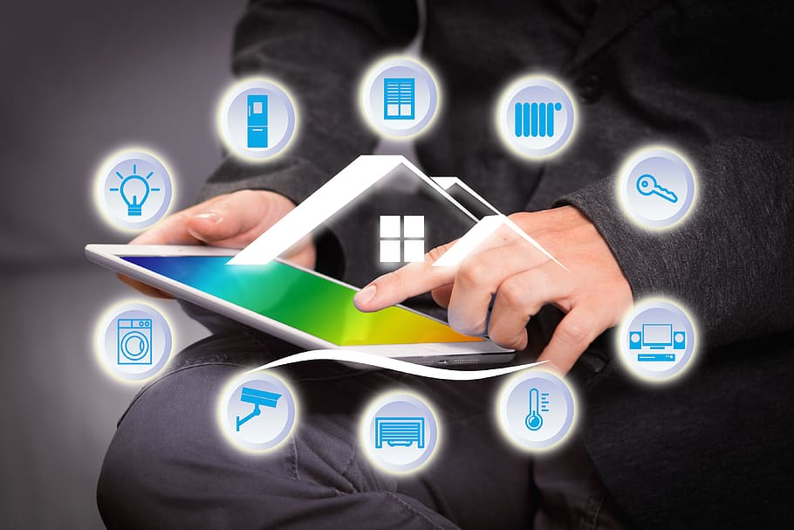
Assignment
Search for examples of applications for smart homes
Present your result to your colleagues
2017-1-DE03-KA201-035615

Slide 5
Create a gas leakage monitoring and control system
The system should:
Include an user interface
Detect the gas leakage using gas sensor(s)
Alert when a gas leakage is detected with a buzzer and/or a led
Turn off the gas source in case of gas leakage (using a servomotor)
2017-1-DE03-KA201-035615

Slide 6
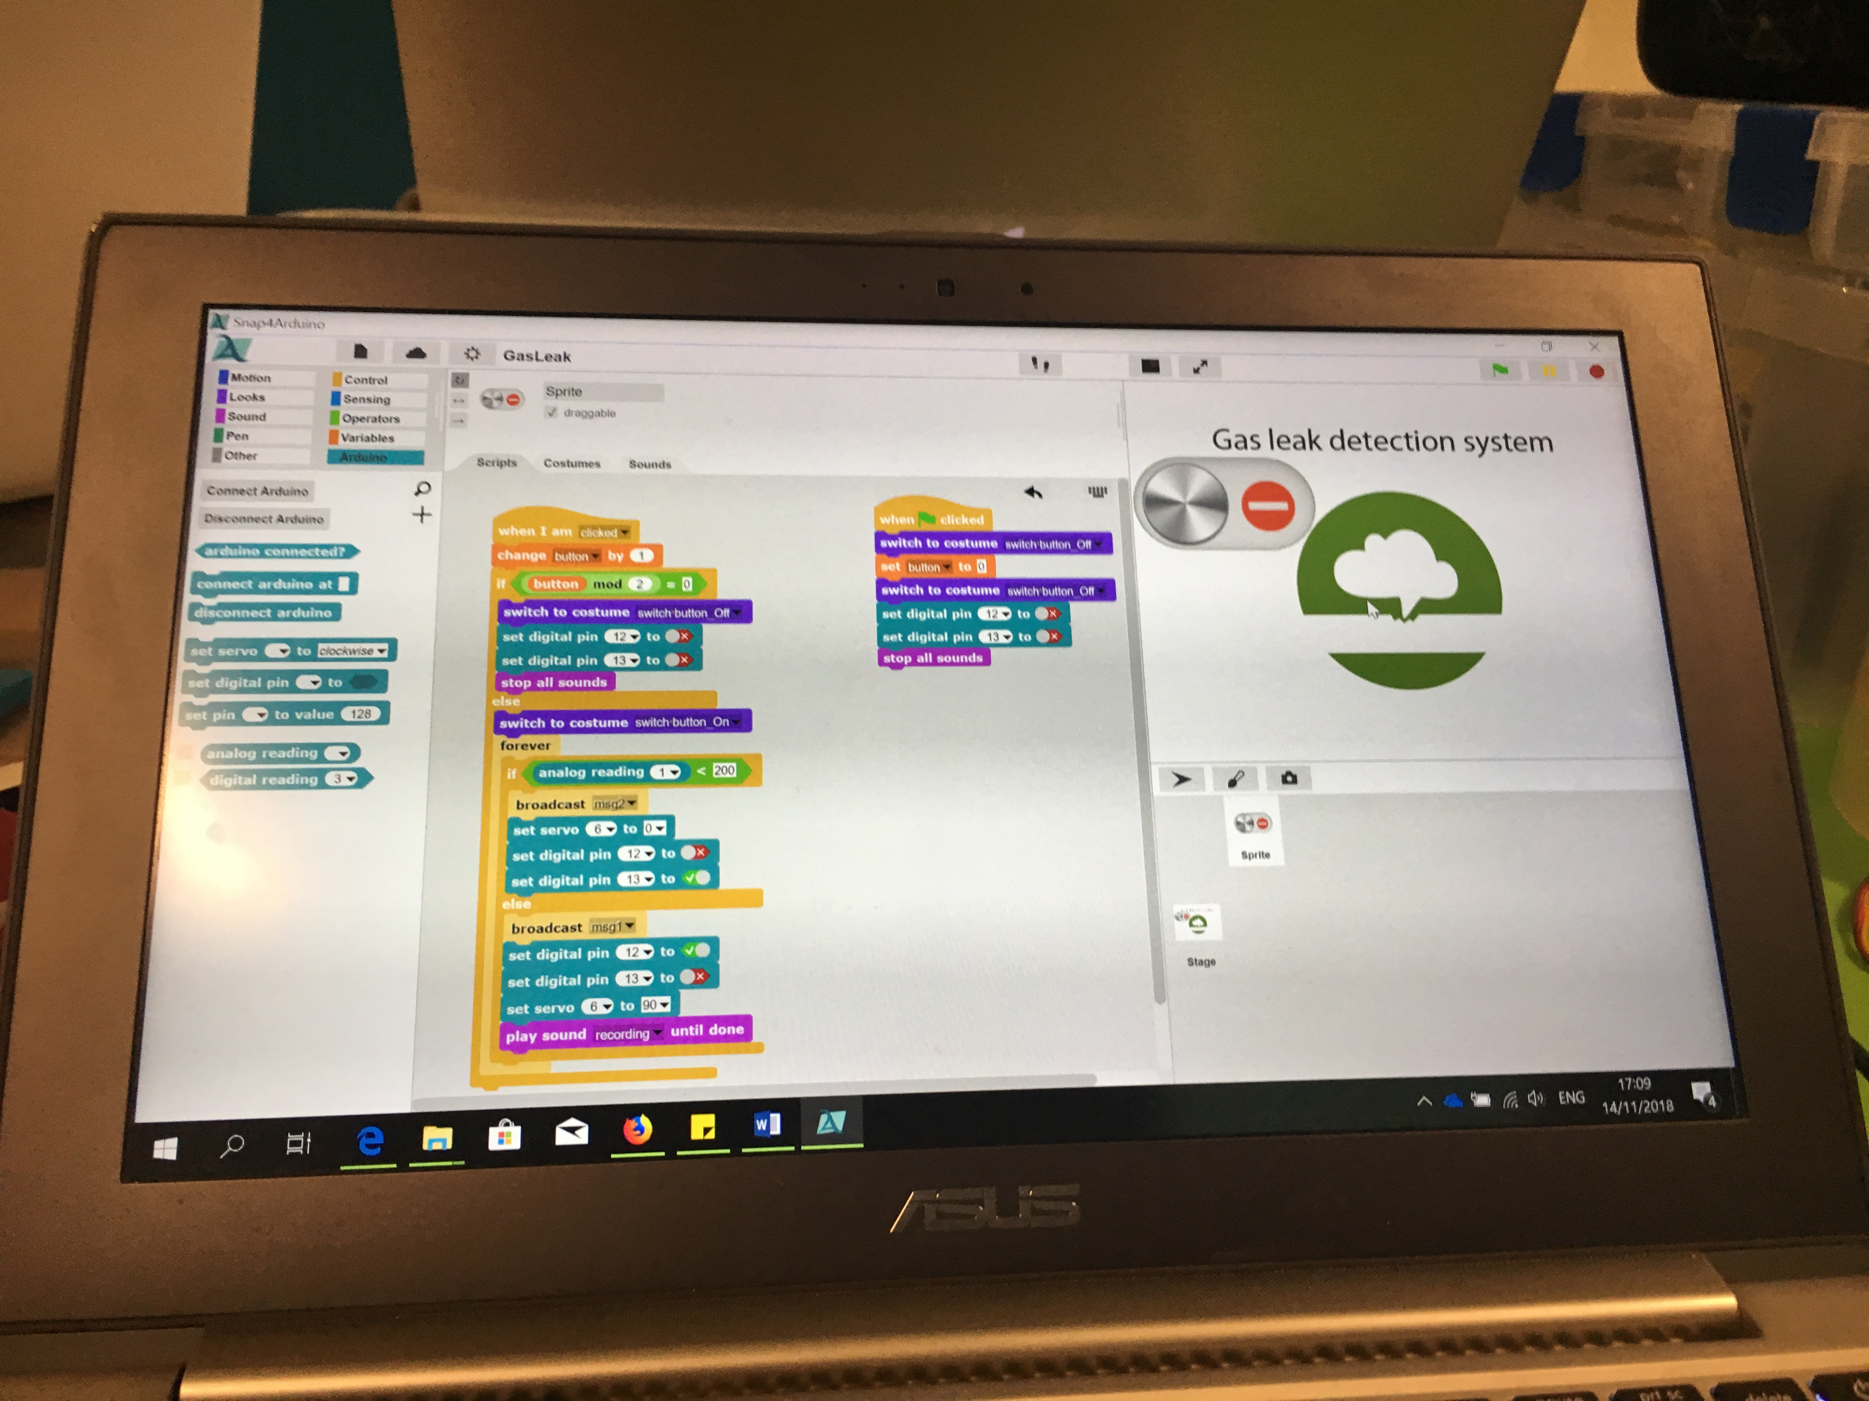
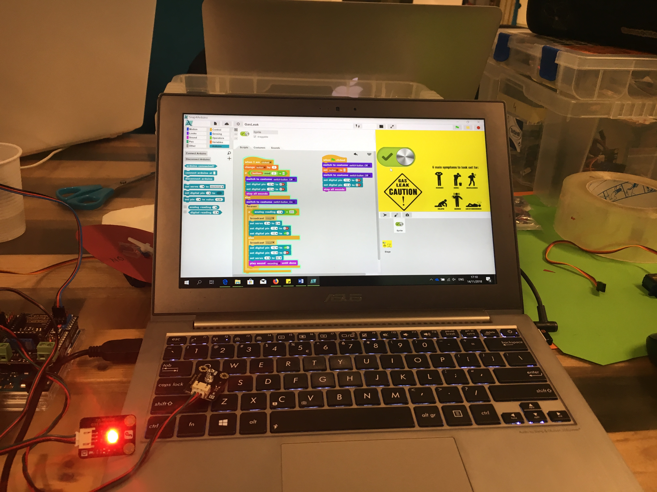
Create a gas leakage monitoring and control system
2017-1-DE03-KA201-035615

Slide 7
References
Stevens, L., 2018, What is a smart home? How your future family house will look and think, https://home.bt.com/tech-gadgets/internet/connected-home/what-is-a-smart-home-11364214165664
Images sources:
Slide 2: https://cdn.pixabay.com/photo/2017/01/24/18/02/smart-home-2005993_960_720.png
Slide 3:
https://static.bhphoto.com/images/images2500x2500/1507046817_1365637.jpg
https://lh3.googleusercontent.com/igThvoKwToXtZOfTANWbgp2ZoLnPBV2KDt9oJuaK419yIHQIo24eIcsCbgWcnfwlFjs=w1000
Slide 4:
https://p0.piqsels.com/preview/87/1008/843/smart-home-house-technology-multimedia.jpg
2017-1-DE03-KA201-035615

